Slide 1
NLP

Slide 2
Deep Learning
Word Embeddings

Slide 3
What Is the Feature Vector x?
Typically a vector representation of a single character or word
Often reflects the context in which that word is found
Could just do counts, but that leads to sparse vectors
Commonly used techniques
word2vec or GloVe
https://code.google.com/p/word2vec/
includes the models and pre-trained embeddings
Pre-trained is good, because training takes a lot of data
Gensim: Python library that works with word2vec
https://radimrehurek.com/gensim/
Notes:
Strictly speaking, learning word embeddings isn’t necessarily deep learning
But deep learning for NLP uses these … as do many non-deep techniques (e.g., HW3)

Slide 4
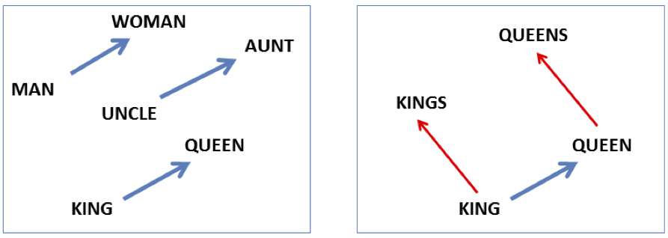

Embeddings Are Magic, Part 1
vector(‘king’) - vector(‘man’) + vector(‘woman’) $≈$vector(‘queen’)
Image courtesy of Jurafsky & Martin

Slide 5
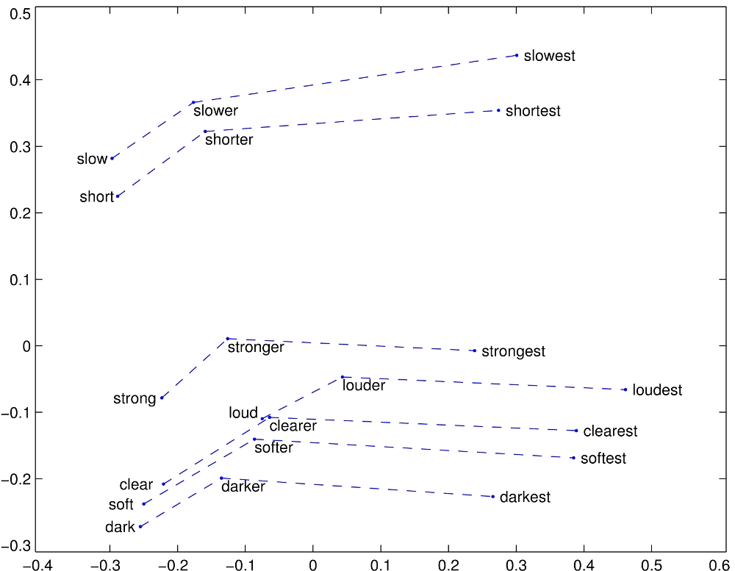
Embeddings Are Magic, Part 2
GloVe vectors for comparative and superlative adjectives
http://nlp.stanford.edu/projects/glove/images/comparative_superlative.jpg

Slide 6
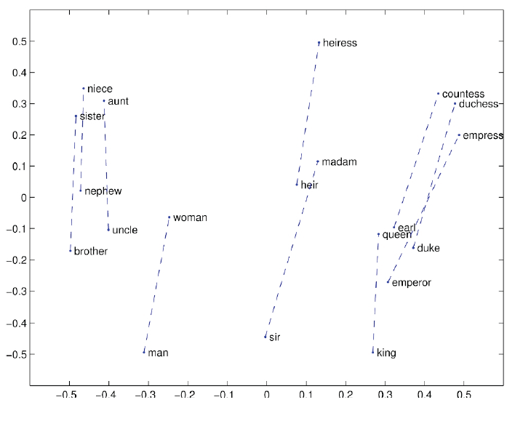
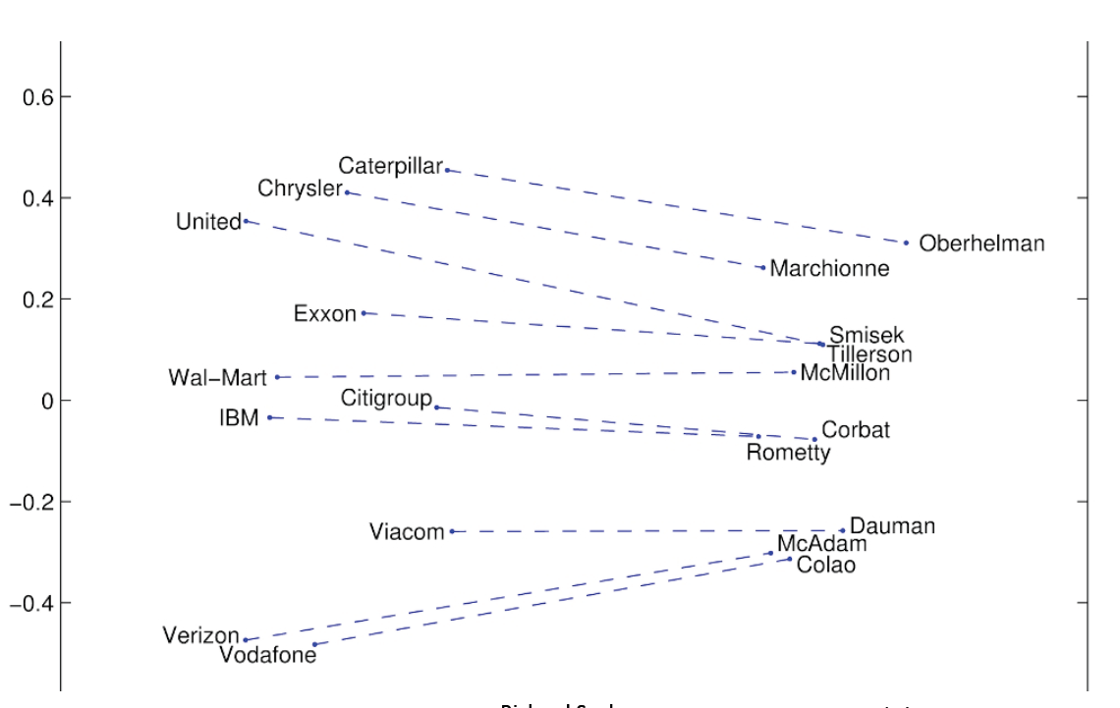
More Examples
Examples from Richard Socher

Slide 7
Skip-grams
Predict each neighboring word
in a context window of 2C words
from the current word.
E.g., for C=2, we are given word w_{t} and predicting these 4 words:

Slide 8
Skip-grams learn 2 embeddings for each w
input embedding v, in the input matrix W
Column i of the input matrix W is the 1×d embedding v_{i} for word i in the vocabulary.
output embedding v′, in output matrix W’
Row i of the output matrix W′ is a d × 1 vector embedding v′_{i} for word i in the vocabulary.
[Jurafsky & Martin]
Notes:
Weird notation issue: Textbook calls the output matrix C, even though these are the slides intended to correspond to the textbook chapter. The risks of working with a draft.

Slide 9
Setup
Walking through corpus pointing at word w(t), whose index in the vocabulary is j, so we’ll call it w_{j} (1 < j < |V|).
Let’s predict w(t+1), whose index in the vocabulary is k (1 < k < |V |). Hence our task is to compute P(w_{k}|w_{j}).
Slide courtesy of Jurafsky & Martin

Slide 10
CBOW and skipgram (Mikolov 2013)
w_{i-2}
w_{i-2}
w_{i-1}
w_{i-1}
Σ
w_{i}
w_{i}
w_{i+1}
w_{i+1}
w_{i+2}
w_{i+2}

Slide 11
Skip-gram
Slide courtesy of Jurafsky & Martin
Notes:
If we take our one-hot vector and multiply it by our W matrix, that gives us a vector that we call the projection layer – it’s just the column in W that corresponds to the word we’re looking at.

Slide 12
Skip-gram
h = v_{j}
o = W’h
o = W’h
Slide courtesy of Jurafsky & Martin
Notes:
We take the dot product of this projection layer, which is sometimes called h or v_j, with W’.
This gives us a vector o of values, with one value for each word in the vocabulary.
We normalize it using a function called softmax, so that the numbers in the output vectors become probabilities. The cost function then is based on how probable the model thought the correct context words were.
CBOW, or continuous bag of words, is like backwards skipgram: given the context words, try to predict the target word.
So now we know what our input is going to be. Let’s look at some networks that use them.

Slide 13
Notes
One-hot vectors
A vector of length |V|
Example: [0,0,0,0,1,0,0,0,0…….0]
Sparse vs. dense vectors
100,000 dimensions vs. 300 dimensions
<10 non-zero dimensions vs. 300 non-zero dimensions
Dense vectors
Semantic similarity (cf. LSA)

Slide 14
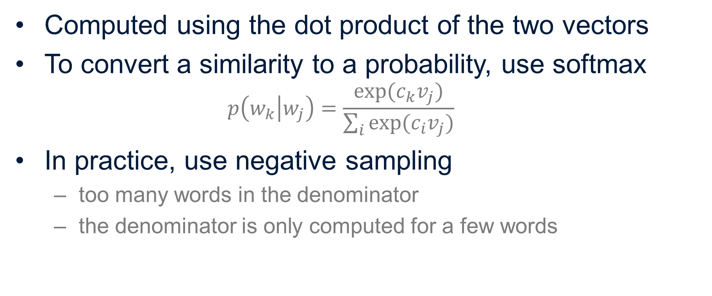
Similarity Computation
Computed using the dot product of the two vectors
To convert a similarity to a probability, use softmax
$$p\left(w_{k} | w_{j}\right)=\frac{exp⁡(c_{k}v_{j})}{\sum_{i}{exp⁡(c_{i}v_{j})}}$$
In practice, use negative sampling
too many words in the denominator
the denominator is only computed for a few words

Slide 15
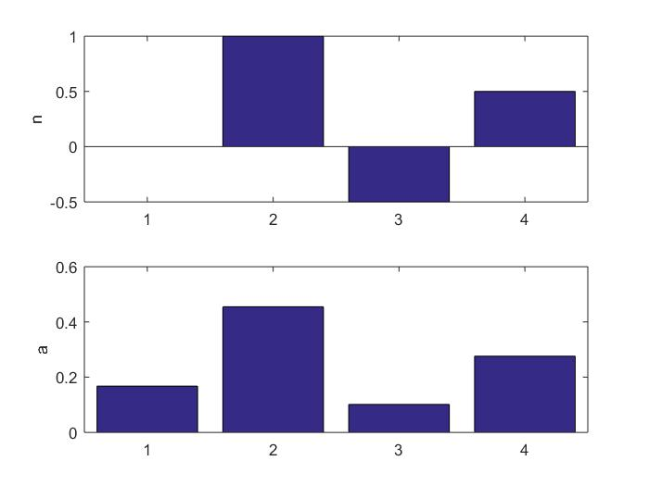
Softmax
Notes:
Jordan, M.I. (1986). Serial order: A parallel distributed processing approach.
LSTM (1997)
Predecessor to CNNs first introduced in 1980, developed in 1988, improved in 1998.

Slide 16
Evaluating Embeddings
Nearest Neighbors
Analogies
(A:B)::(C:?)
Information Retrieval
Semantic Hashing

Slide 17
Similarity Data Sets
[Table from Faruqui et al. 2016]

Slide 18
[Mikolov et al. 2013]

Slide 19
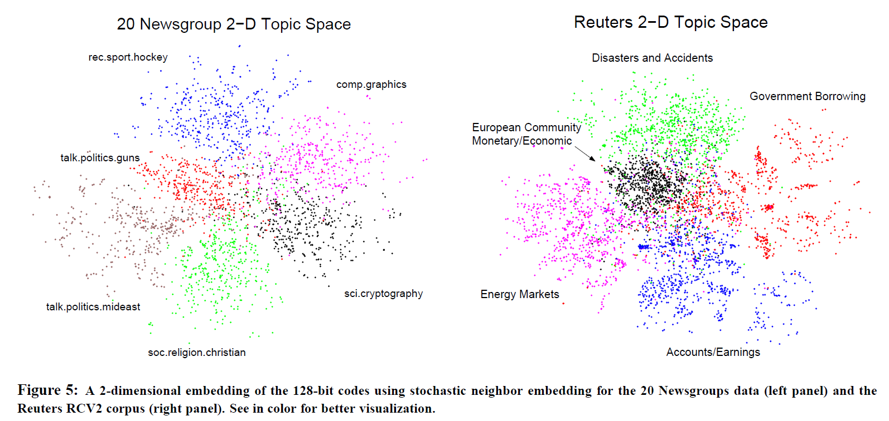
Semantic Hashing
[Salakhutdinov and Hinton 2007]

Slide 20
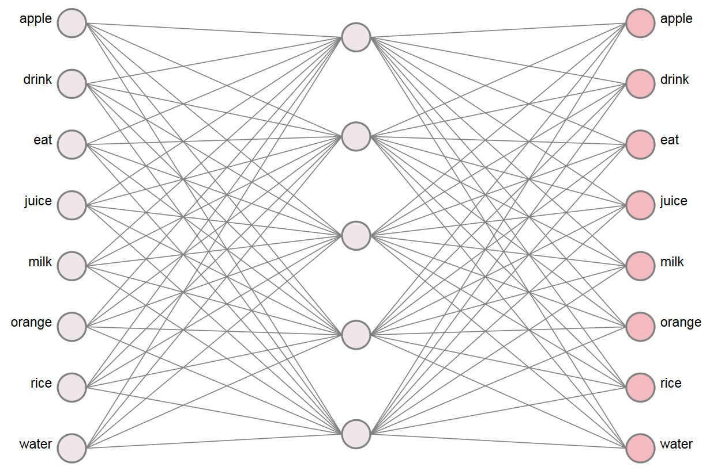
WEVI (Xin Rong)
https://ronxin.github.io/wevi/
eat|apple, eat|orange, eat|rice, drink|juice, drink|milk, drink|water, orange|juice, apple|juice, rice|milk, milk|drink, water|drink, juice|drink

Slide 21
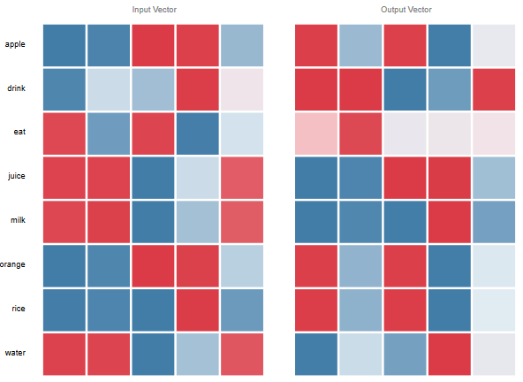
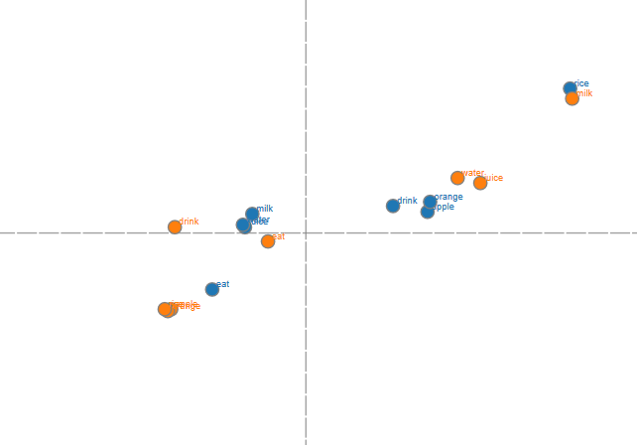

Slide 22
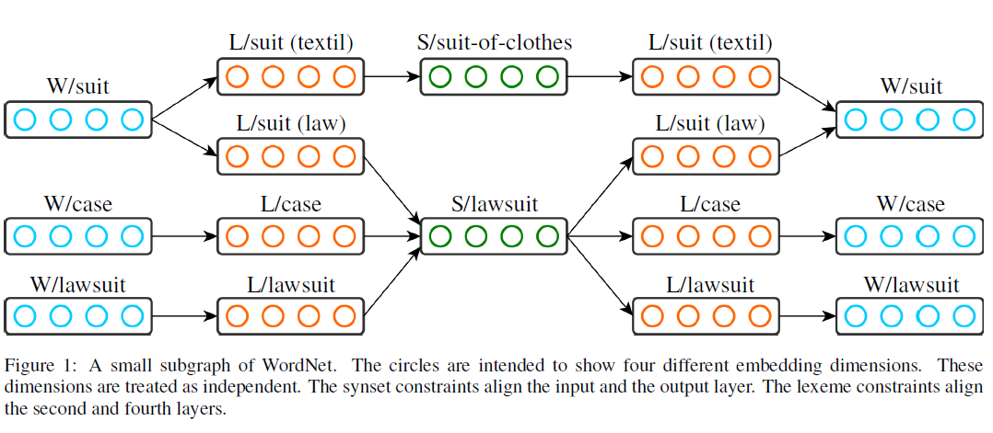
Embeddings for Word Senses
[Rothe and Schuetze 2015]

Slide 23
Non-compositionality
BLACK CAT = BLACK + CAT
BLACK MARKET ≠ BLACK + MARKET

Slide 24
Notes
Word embeddings perform matrix factorization of the co-occurrence matrix
Word2vec is a simple feed-forward neural network
Training is done using backpropagation using SGD
Negative sampling for training

Slide 25
NLP

